Slide 1
PiezoMEMS
Design for Test
Joe Evans, Naomi Montross, Spencer Smith, Bob Howard, Scott Chapman
Radiant Technologies, Inc.
2019 International Workshop on Piezoelectric MEMS
July 16, 2019

Slide 2
Summary
Radiant has long considered what test instruments and procedures will be needed to characterize piezoMEMS. Certainly, a more complex test architecture is required than that for simple capacitors. New test procedures and specialized fixtures will both be necessary to reduce the time required to evaluate each design once it comes off the wafer. In turn, each pMEMS device must be designed to function within the new test architecture.

Slide 3
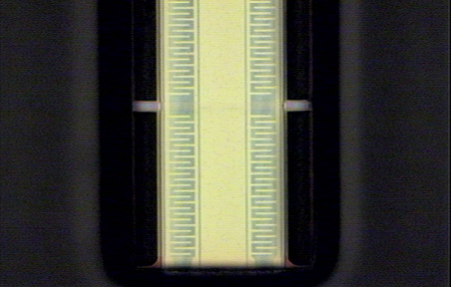
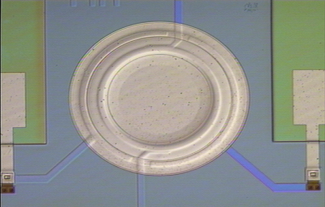
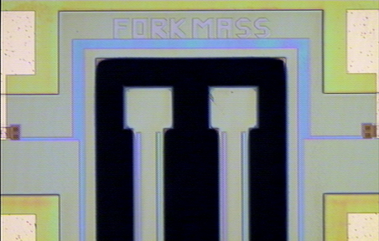
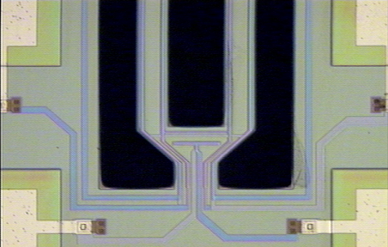
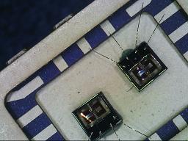
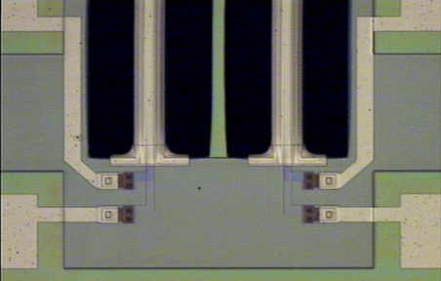
Introduction
  Radiant is now generating devices from an in-house piezoMEMS process under development since 2008.
  Radiant is adding new infrastructure to its testers to evaluate these devices.

Slide 4
Issues
    Some of the new devices contain five capacitors. Every capacitor on every device must be tested for its ferroelectric properties.
    New tests are needed to evaluate electromechanical properties.
    The devices will embed into their own control circuits in order to operate autonomously. Test hardware must now test circuits.
    The circuits must see elevated temperature to determine long-term reliability.
    Some sort of packaging is necessary to allow the pMEMS devices to be physically handled and inserted into circuit boards.
    Radiant put 38 different individual pMEMS and solid state device circuits on its development wafer. Every one of those dice must be characterized in order to make appropriate improvements to the process. Each device requires a different test board.

Slide 5




Packaging
    Traditional IC packages are expensive and require wire bonding.
    Packages may also interfere with the functionality of pMEMS sensors because the package isolates the sensor from its ambient environment.
    Radiant decided to discard traditional packages and solder dice directly onto PC boards.
    Old fashioned copper/gold solder pads on the die match SOIC solder pads on the PC board. The die flips over so the pMEMS is face down and looks out the underside of the die. The delicate parts of the MEMS are protected.
Die Floor
Plan
Radiant uses an SOIC format with a 3.4mm x 3.4mm die floor plan.

Slide 6
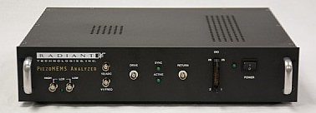
PiezoMEMS Tester
  To interface with analog/digital circuits surrounding the pMEMS, Radiant has added additional functions to the Precision Multiferroic tester to create the Precision PiezoMEMS tester.
  True LCR
  Digital I/O
  I²C communications
  DC Voltage Source for powering circuits.
  Frequency Counter
  Asynchronous Pulse Generator
  Asynchronous 16-bit Voltage Measurement
New Vision Tasks are being written: Impulse Response, Resonance Excitation, and Quality Factor determination.

Slide 7
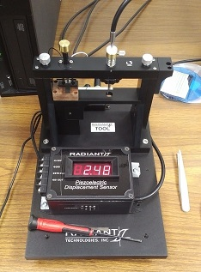
Impulse Response
  Below is the tip displacement of an Radiant 42mm e₃₁ cantilever after an electrical Impulse event. FFT the polarization and the displacement traces.
Resonance = 311Hz

Slide 8
Resonance Response
  Next, apply a continuous stimulus of small amplitude to the cantilever at its resonant frequency. Qm will cause the mechanical displacement to grow.
2nd Harmonic = 622Hz

Slide 9

FWHM
  The Quality Factor can be estimated from the FFT of the Resonance Curve. Divide the resonant frequency by its Full Width at Half Maximum in Hertz.
Resonant Frequency
$Q= \frac{311.45}{\left(312.05 − 310.87\right)}$ ~ 264
FWHM

Slide 10
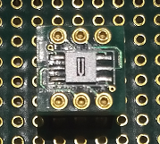
Complete Test Sequence
  Consider this tuning fork, it has three capacitors. The following test sequence must be executed individually on all three capacitors of the die.
  Ferroelectric Polarization/Leakage/etc.
  Set the Poling direction for operation
  Impulse Response
  Resonance Response
  Quality Factor
  Insert device into its control circuit
  Track resonance with Frequency Counter.

Slide 11
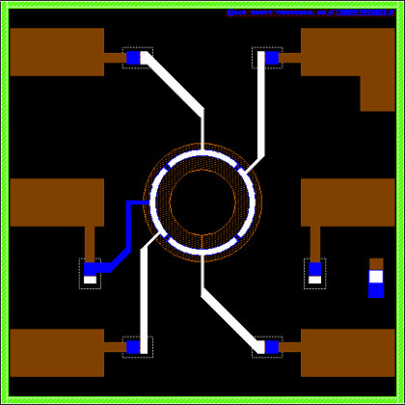
Example Test Flow
Consider a four-capacitor accelerometer. It will have four capacitors with five connections if all capacitors share a common ground.
Circuit diagram:
Proof Mass

Slide 12
Test Each Cap Individually
After fabrication, each capacitor should be tested in turn for shorts, hysteresis, & leakage. These are all classic ferroelectric tests.
Each capacitor is poled to its proper polarity and then tested for Impulse, Resonance, and Quality Factor if the device is to be a sensor.
Return
Drive
piezoMEMS Analyzer

Slide 13
Test Each Cap Individually
After fabrication, each capacitor should be tested in turn for shorts, hysteresis, & leakage. These are all classic ferroelectric tests.
Each capacitor is poled to its proper polarity and then tested for Impulse, Resonance, and Quality Factor if the device is to be a sensor.
Return
Drive
piezoMEMS Analyzer

Slide 14
Test Each Cap Individually
After fabrication, each capacitor should be tested in turn for shorts, hysteresis, & leakage. These are all classic ferroelectric tests.
Each capacitor is poled to its proper polarity and then tested for Impulse, Resonance, and Quality Factor if the device is to be a sensor.
Return
Drive
piezoMEMS Analyzer

Slide 15
Test Each Cap Individually
After fabrication, each capacitor should be tested in turn for shorts, hysteresis, & leakage. These are all classic ferroelectric tests.
Each capacitor is poled to its proper polarity and then tested for Impulse, Resonance, and Quality Factor if the device is to be a sensor.
Return
Drive
piezoMEMS Analyzer

Slide 16
A Mux Helps
Radiant now has a dual 1:8 multiplexer that allows Vision to control all four capacitors from within a Test Definition.
Multiplexer
Return
Drive
I²C
piezoMEMS Analyzer

Slide 17
Connect the Outer Circuit
The sample is inserted into its circuit which will control and amplify its signals. The circuit outputs are tested with the voltage sensing ports of the tester and with the new Frequency Counter.
PC Circuit Board
V1
Power
Sensor2
piezoMEMS Analyzer
Sensor 1

Slide 18
Into the Chamber
Finally, the pMEMS and its circuit will be inserted into a temperature chamber for two days of testing at room temperature and 85°C.
V1
Power
Sensor 1
Sensor2
piezoMEMS Analyzer
I²C/USB

Slide 19
Specialized Test Fixtures
Radiant is developing two new test fixtures specialized for pMEMS and component level testing.
  The Low Voltage High Temperature Component Fixture
2. The Precision pMEMS Analyzer Test Matrix Board

Slide 20
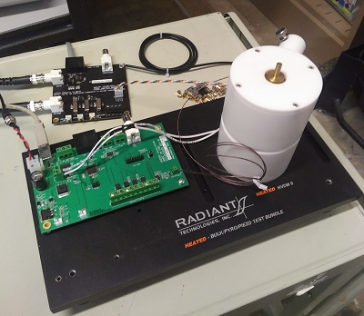
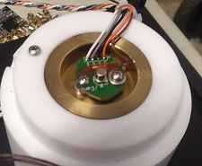
Prototype Component Fixture
PNDS TO-18 Board
DRIVE/RETURN
PNDS 2-Channel Mux
Thermocouple
I²C
Dual capacitors in a single TO-18 package
Reliability testing of platinum-electrode PZT capacitors was previously reported by Radiant at the 2018 IWATMD Penn State meeting using this temperature chamber created out of extra parts at Radiant.
USB
Power
Original HVTF modified for optical heating.
Thermal Controller from the HVDM II
Already tested packages

Slide 21
Imprint Characterization
Simultaneous 85°C opposite-state curves (red) for two capacitors for 24 hours. Results indicate potential >30 years imprint lifetime .
Blue = Retention
Red = Imprint
Retention Results: PZT never forgets!
From IWATMD 2018
30 years

Slide 22
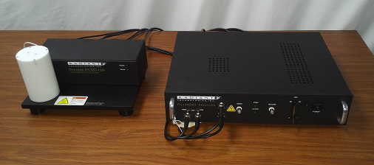
LVH
The LVH will be the commercial version of that original component thermal chamber.
The Low Voltage High Temperature Component Fixture brings all signals from the Precision piezoMEMS tester to a mother board inside a Teflon test chamber controlled from Vision.
  Rated temperature: 110°C

Slide 23
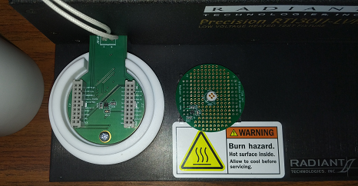
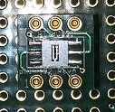
LVH
The Mother board inside the chamber has connectors that bring the signals to a Daughter board.
Radiant has its own general-purpose Daughter boards but a custom PCB can easily be fabricated to fit the Mother board for special dice.
Socket for Radiant’s Type AB packaged capacitors.
The PCB with the pMEMS die is a “Baby” board.

Slide 24
Matrix Board
The Matrix Board will have an array of unbuffered BNC input connectors and buffered BNC output connectors to allow signals to pass between the piezoMEMS Analyzer and a Device Under Test in the center of the board.
A relay matrix surrounding a central Daughter board will allow Vision to connect any pin of the pMEMS device package to any BNC or to a feedback path for the device.
In theory, any one of the 38 different die types on Radiant’s development wafer will be able to be inserted into the center Daughter board and have its PCB pins connected to the proper signals from the tester by Vision without having to solder wires to the Matrix Board.
The Matrix Board should dramatically reduce the labor hours and calendar time required to setup and test new designs. As a small company, Radiant cannot move forward in its pMEMS development without the functionality offered by such an automated test board.

Slide 25
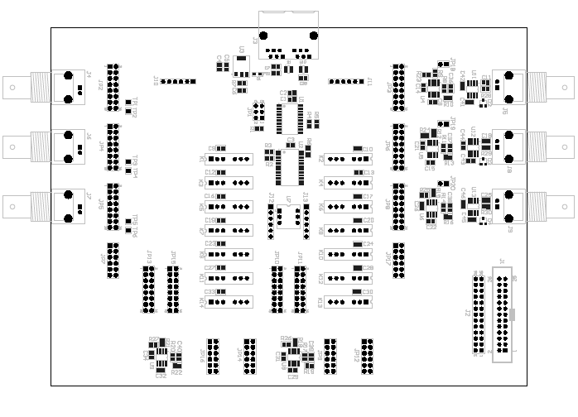
Matrix Board
This is a very complex system for which development just started. It may not be successful!

Slide 26
Conclusion
  Radiant recently processed its first piezoMEMS wafer through die-on-PCB.
  Each device type must now be tested and made to perform its targeted function.
  All die layouts were forced to fit onto a standard floorplan to ease the labor required to package and test each device type.
  New Vision Tasks are being written to characterize the electromechanical properties of the piezoMEMS.
  Four new instruments or fixtures are in development to support testing:
    PiezoMEMS Analyzer
    Precision Multiplexer
    LVH Temperature Component Test Fixture
    Test Matrix Board.

